Slide 1
Getting Started by Dr. Zubair Shah

Slide 2
Agenda of this week classes
Anaconda
Introduction to Anaconda
Installation and settings
Virtual environments
Jupyter Notebook
Introduction to Jupyter Notebook
Installations and settings
Python programing
Strings and Numbers in Python
Introduction to Python

Slide 3
Anaconda
Anaconda is a Python distribution that is particularly popular for data analysis and scientific computing
Open source project developed by Continuum Analytics, Inc.
Available for Windows, Mac OS and Linux
Includes many popular packages: NumPy, SciPy, Matplotlib, Pandas, IPython, Cython
Includes Spyder and Jupyter, Python development environments
Includes conda, a platform-independent package manager

Slide 4
Anaconda Installation
Anaconda is easy to install
Download installer from https://www.anaconda.com/products/individual#windows
Execute the installer and follow the instructions

Slide 5
Python packages
Simplifies installation of Python packages
Provides “virtual environment” capabilities
Documentation at http://conda.pydata.org.docs/

Slide 6
Installing Python packages with Conda
Install
It can be as easy as:
Specify
Specify versions of packages can be requested:
conda install -c anaconda python=3
Use
Use pip:
pip install intervaltree
conda install -c anaconda python

Slide 7
Virtual Environments
Environments allow different versions of packages on same machine
Create environment “CPEG110”
conda create --name CPEG110
Environments must be activated
On Mac OS X and Linux:
source activate CPEG110
python
...
source deactivate
On Windows:
> activate CPEG110
> python
...
> deactivate

Slide 8
More Conda operations
Display
Display help for conda command (and sub-commands):
conda --help
conda list --help
List
List packages in current conda environment:
conda list
Display
Display all information about conda installation:
conda info -a
Search
Search for available packages (using regular expressions):
conda search ’^doc’ # packages that start with "doc"
Update
Update package:
conda update python
Uninstall
Uninstall package:
conda remove python

Slide 9
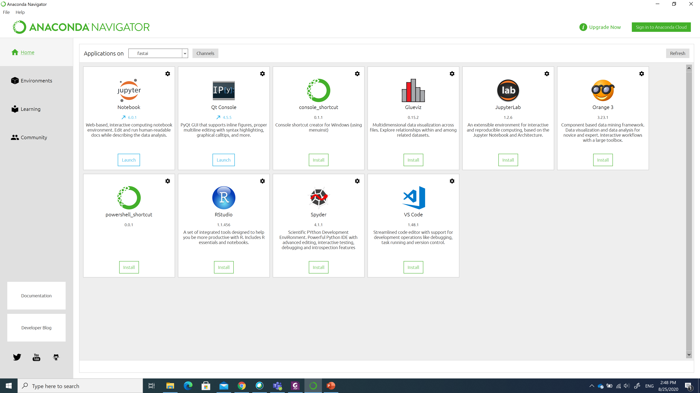
Anaconda Navigator (GUI based) available from windows start menu

Slide 10
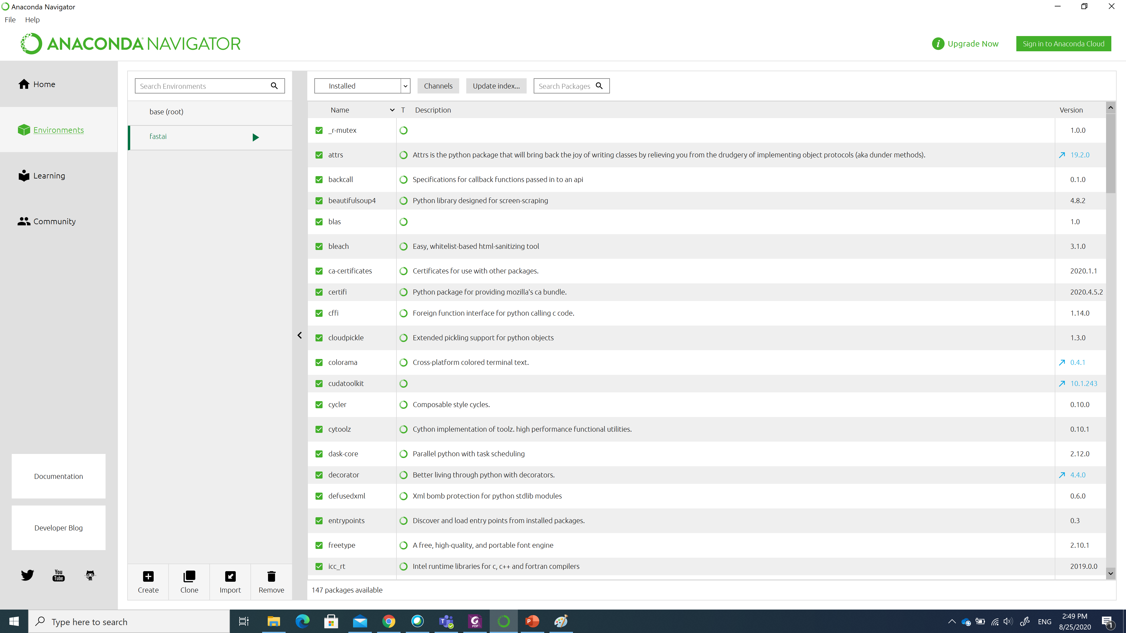
Same command-based options available here as well

Slide 11

Demo

Slide 12
Jupyter Notebook

Slide 13

What are notebooks?
A notebook combines the functionality of
a word processor — handles formatted text
a "shell" or "kernel" — executes statements in a programming language and includes output inline
a rendering engine — renders HTML in addition to plain text

Slide 14
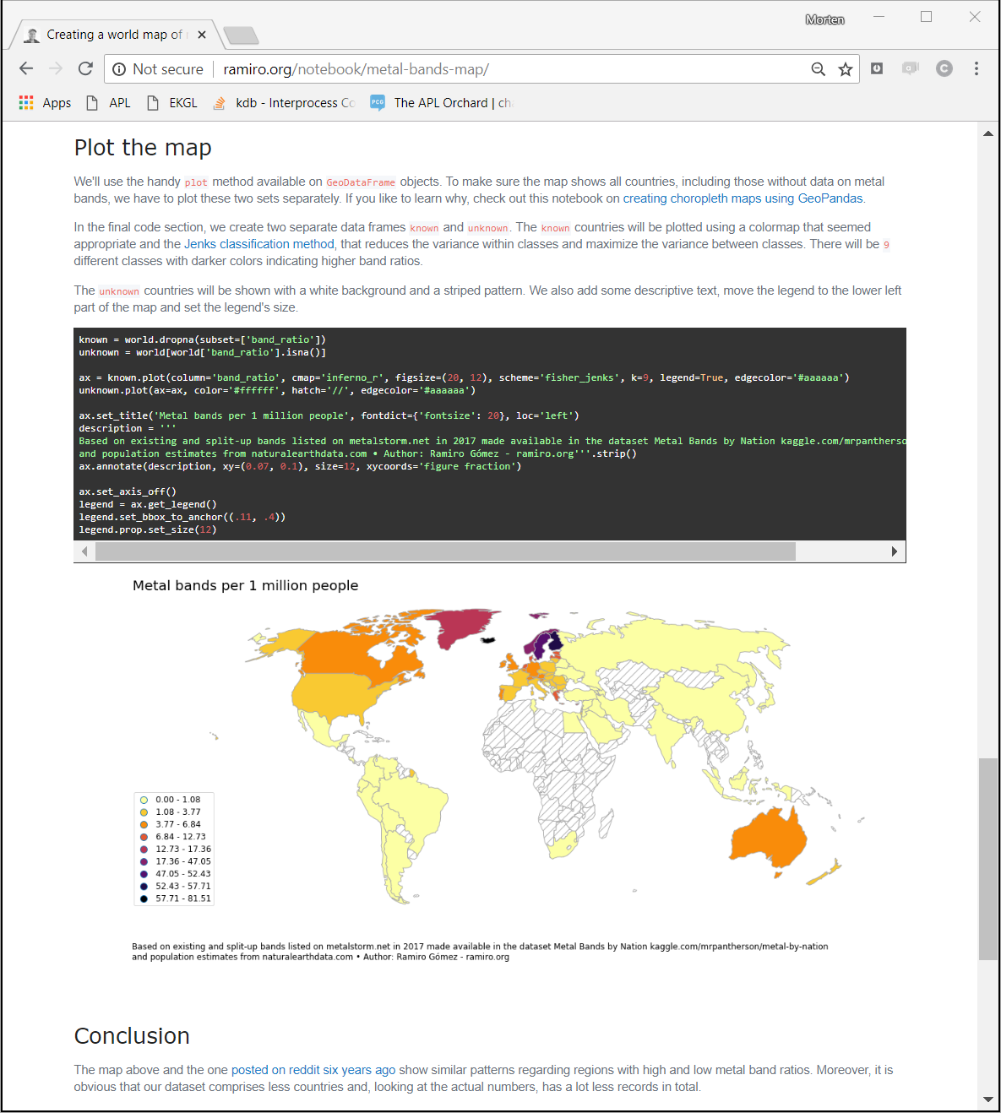
Example notebook using Python

Slide 15
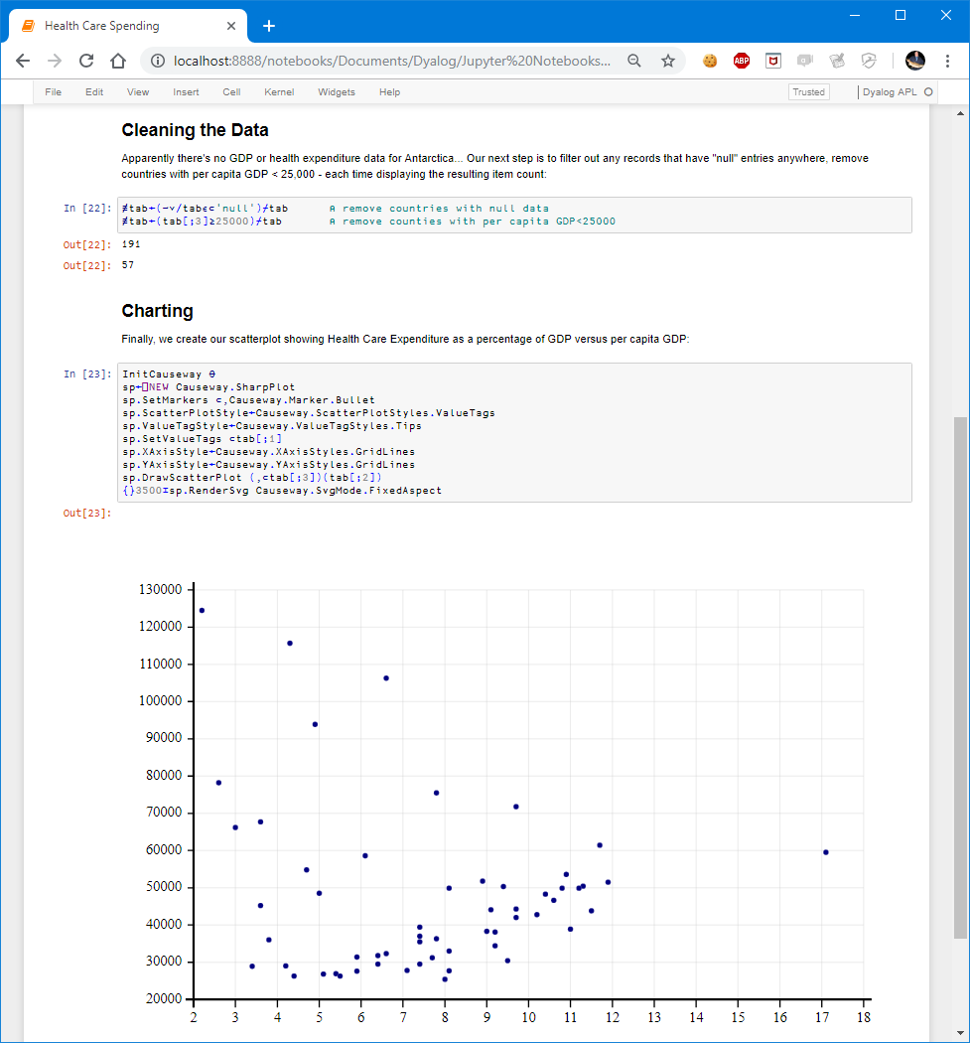
Example notebook using Python

Slide 16
What is Jupyter notebook?
Jupyter notebook is a part of Project Jupyter to develop open-source software, standards, and services for interactive computing across dozens of programming languages
beginning with Julia, Python, R, and now over 70 languages

Slide 17
Jupyter Notebook Server Installation
Jupyter Notebook server should be installed within the virtual environment created by conda command
Installation using conda
conda install -c conda-forge notebook
Installation using pip
pip install notebook
Running Jupyter Notebook server
jupyter notebook

Slide 18
Notebook Configuration
The Notebook web server configuration options are set in a file named jupyter_notebook_config.py in your Jupyter directory, which itself is usually .jupyter in your home directory.
In window it is in:
“C:\Users\<user name>\.jupyter\”
If the .jupyter folder does not contain a jupyter_notebook_config.py file, you need to generate it with conda command
jupyter notebook --generate-config
One important configuration is to set starting directory
c.NotebookApp.notebook_dir = ‘path//to/your//directory’
Demo
C:\Users\zshah\.jupyter

Slide 19
Notebook benefits
A single document that combines explanations with executable code and its output — an ideal way to provide:
reproducible research results
documentation of processes
Instructions
tutorials and training materials
A digital learning environment for computational thinking

Slide 20
Ways to use Jupyter notebooks
On your own computer after installing a Jupyter notebook server
With an online notebook server like cocalc.com and colab.research.google.com
Save notebook with output and use a notebook viewer
Export to HTML, PDF, LATEX, etc.

Slide 21
Local notebook server — Python
Anaconda Python platform
notebook server
localhost:8888
interpreter
Python
Jupyter kernel for Python

Slide 22
To do
Create
Create a working folder on your computer where you will practice and keep the class material and point to this folder in configuration file jupyter_notebook_config.py
Start
Start anaconda cmd or GUI
Activate
Activate your environment
Run
Run Jupyter Notebook server
Start
Start your python coding

Slide 23
Demo

Slide 24

Python Programming

Slide 25
Introduction to Python
Python is a general purpose, dynamic, high level and interpreted programming language. It supports Object Oriented programming approach to develop applications. It is simple and easy to learn and provides lots of high-level data structures.
Python is easy to learn yet powerful and versatile scripting language which makes it attractive for Application Development.
Python's syntax and dynamic typing with its interpreted nature, makes it an ideal language for scripting and rapid application development.
Python supports multiple programming pattern, including object oriented, imperative and functional or procedural programming styles.

Slide 26
Introduction to Python continue…
Python is not intended to work on special area such as web programming. That is why it is known as multipurpose because it can be used with web, enterprise, 3D CAD etc.
We don't need to use data types to declare variable because it is dynamically typed so we can write a=10 to assign an integer value in an integer variable.
Python makes the development and debugging fast because there is no compilation step included in python development and edit-test-debug cycle is very fast

Slide 27
Python Features
Easy to Learn and Use
Python is easy to learn and use. It is developer-friendly and high-level programming language.
Expressive Language
Python language is more expressive means that it is more understandable and readable.
Interpreted Language
Python is an interpreted language i.e. interpreter executes the code line by line at a time.
This makes debugging easy and thus suitable for beginners.
Cross-platform Language
Python can run equally on different platforms such as Windows, Linux, Unix and Macintosh etc. So, we can say that Python is a portable language.
Free and Open Source
Python language is freely available at official web address. The source-code is also available. Therefore it is open source.

Slide 28
Python Features
Object-Oriented Language
Python supports object-oriented language and concepts of classes and objects come into existence.
Extensible
It implies that other languages such as C/C++ can be used to compile the code and thus it can be used further in our python code.
Large Standard Library
Python has a large and broad library and provides rich set of module and functions for rapid application development.
GUI Programming Support
Graphical user interfaces can be developed using Python.
Integrated
It can be easily integrated with languages like C, C++, JAVA etc.

Slide 29
Syllabus
Module 0 - Introduction to number systems and basic Boolean logic
Module 1 - Introduction to Python and Computer Programming
Module 2 - Data Types, Variables, Basic Input-Output Operations, Basic Operators
Module 3 - Boolean Values, Conditional Execution, Loops, Lists and List Processing, Logical and Bitwise Operations
Module 4 - Functions, Tuples, Dictionaries, and Data Processing
Module 5 - Modules, Packages, String and List Methods, and Exceptions
Module 6 - The Object-Oriented Approach: Classes, Methods, Objects, and the Standard Objective Features; Exception Handling, and Working with Files

Slide 30
Next, lets begin
Python programing using notebook
Python Strings
Python Numbers

